Slide 1
Lecture 1
System of linear equations

Slide 2
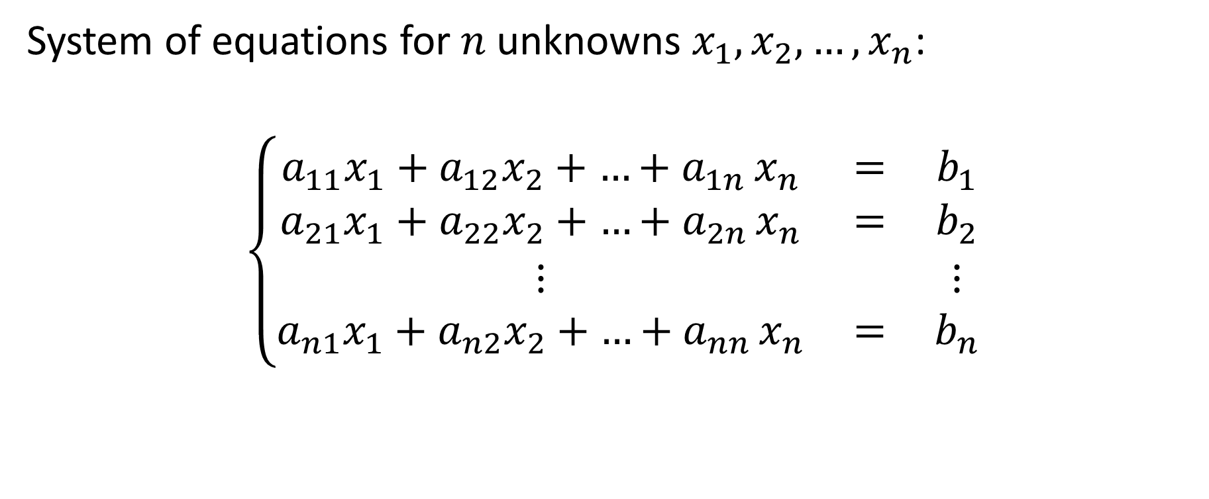
General system of linear equations
System of equations for $n$ unknowns $x_{1},x_{2},…,x_{n}$:
$$\left\{\begin{matrix}a_{11}x_{1}+a_{12}x_{2}+{…+a}_{1n}x_{n} & = & b_{1} \\ a_{21}x_{1}+a_{22}x_{2}+{…+a}_{2n}x_{n} & = & b_{2} \\ ⋮ & & ⋮ \\ a_{n1}x_{1}+a_{n2}x_{2}+{…+a}_{nn}x_{n} & = & b_{n}\end{matrix}\right.$$
Notes:
In this lesson we are going to learn methods to solve systems of linear equations
Such problems are very common in engineering and it is not rare that one has to deal with very large system of 100 or more equations.
During this lesson we are going to deal with systems having the same number of equations and unknowns. Later in the semester we are going to learn how to handle cases where one has more equations than unknowns.
We will use the notation x1, x2 to xn to designate the n unknowns.
A general system of linear equations writes as displayed on the slide.
During you previous studies you have learned how to solve linear system of equations and you may wonder why we would need numerical algorithms for such a problem.
In fact, in a few minutes we are going to learn a closed form solution for a general system of equations of n unknowns.
The problem will however be that, even we can write down a closed form solution, their practical numerical computation is simply too long.
The reason why we will need numerical algorithms will not be because we don’t know a closed form solution of the problem, but because it is too cumbersome and lengthy to compute this solution.
As we will learn in the coming lectures, the algorithms used to solve system of equations are very different in nature than the ones we learned in the case of nonlinear equations.
They will not be iterative in nature and will not provide approximations, but rather will in principle compute the exact solution.
They will have no truncation error.
However, even the algorithms have no truncation error, they will still involve round-off errors.
The consequence is that the numerical solution they will provide will still be an approximation.

Slide 3

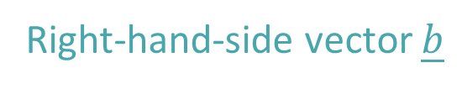
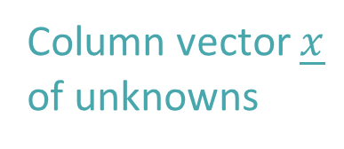
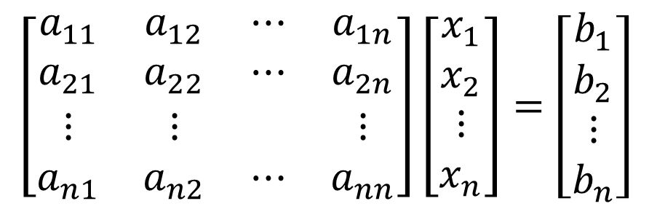
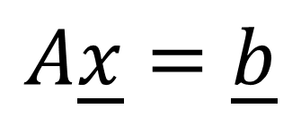
Equivalent matrix equation
Right-hand-side vector $\underline{b}$
$$\left[\begin{matrix}a_{11} & a_{12} & ⋯ & a_{1n} \\ a_{21} & a_{22} & ⋯ & a_{2n} \\ ⋮ & ⋮ & & ⋮ \\ a_{n1} & a_{n2} & ⋯ & a_{nn}\end{matrix}\right]\left[\begin{matrix}x_{1} \\ x_{2} \\ ⋮ \\ x_{n}\end{matrix}\right]=\left[\begin{matrix}b_{1} \\ b_{2} \\ ⋮ \\ b_{n}\end{matrix}\right]$$
Coefficient matrix $A$
Column vector $\underline{x}$
of unknowns
$$A\underline{x}=\underline{b}$$
Notes:
During the coming lectures we will use a more compact and efficient notation to represent system of equations: the matrix notation
For this we introduce the coefficient matrix A, the vector of unknowns x and the right-hand side vector b as shown on the slide.
Using these definitions the matrix equation Ax=b is then equivalent to the linear system of equations with the unknowns x1 to xn.

Slide 4
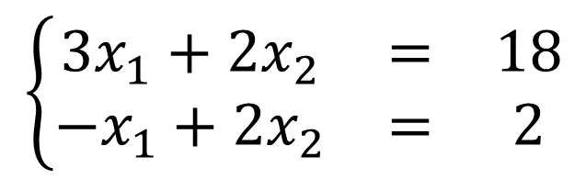
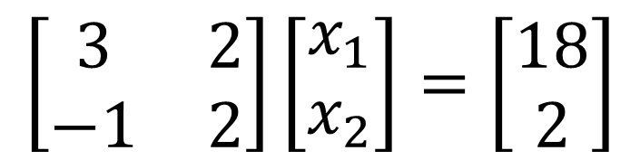
Example
$$\left\{\begin{matrix}3x_{1}+2x_{2} & = & 18 \\ −x_{1}+2x_{2} & = & 2\end{matrix}\right.$$
$$\left[\begin{matrix}3 & 2 \\ −1 & 2\end{matrix}\right]\left[\begin{matrix}x_{1} \\ x_{2}\end{matrix}\right]=\left[\begin{matrix}18 \\ 2\end{matrix}\right]$$
Notes:
Consider a system of equations with two unknowns.
It can be either written in explicit form or in matrix equation.

Slide 5
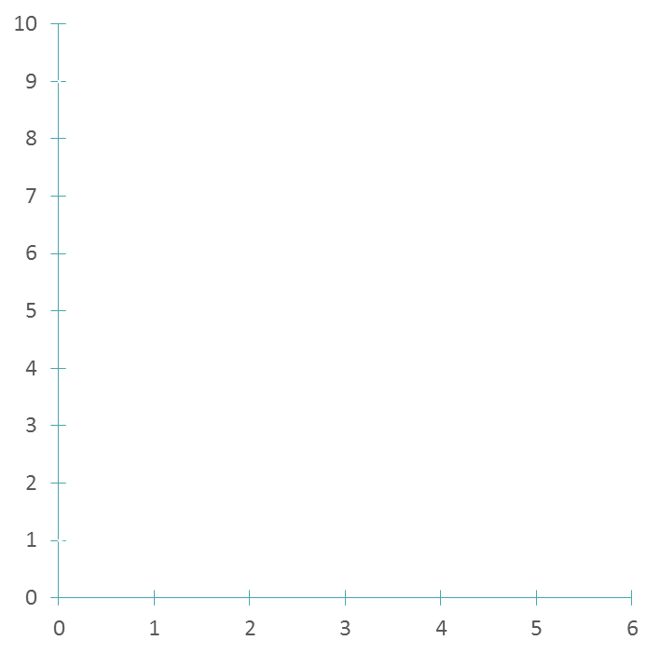



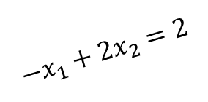
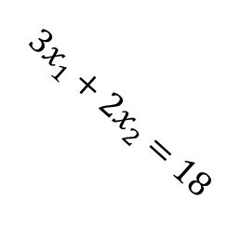
Graphical solution
$$x_{2}$$
$$3x_{1}+2x_{2}=18$$
Solution: $x_{1}=4$, $x_{2}=3$
$$−x_{1}+2x_{2}=2$$
$$x_{1}$$
Notes:
A system with two equations can easily be solved graphically
On plots each equation in a coordinate system
As the equations are linear they will be two straight lines.
Their intercept is the solution of the system of equations.

Slide 6






Solution Space
$$x_{2}$$
$$x_{2}$$
$$x_{2}$$
One solution
Infinite number
of solutions
No solution
$$x_{1}$$
$$x_{1}$$
$$x_{1}$$
Notes:
The advantage of the graphical way to solve a system of equations is that it allows an intuitive understanding of the three cases that may happen
A linear system of equations will have either
Exactly one solution when the two lines representing the equations have one intersection point.
An infinite number of solutions if both equations are represented by a same line
Or no solution at all if the two lines are parallel to each others
These three cases do not only occur for systems with two equations, but are generic for a system of n equations

Slide 7
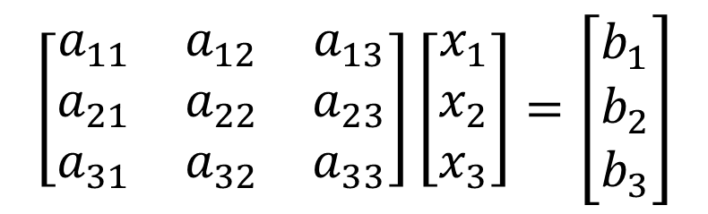
General solution – Cramer’s rule
$$\left[\begin{matrix}a_{11} & a_{12} & a_{13} \\ a_{21} & a_{22} & a_{23} \\ a_{31} & a_{32} & a_{33}\end{matrix}\right]\left[\begin{matrix}x_{1} \\ x_{2} \\ x_{3}\end{matrix}\right]=\left[\begin{matrix}b_{1} \\ b_{2} \\ b_{3}\end{matrix}\right]$$
Notes:
For linear systems of equations a closed form solution can be written down.
Let us give this solution for the particular case of a system with three unknowns
The first unknown x1 is computed by calculating the ratio of two determinants
The denominator is the determinant of the coefficient matrix A of the system.
The numerator determinant is formed as follows
One replaces the first column of the coefficient matrix A by the right hand side vector b.
[Note: maybe good to try to find a way to show this in an animation]
Similarly one computes the second unknown x2
Again the denominator is the determinant of the coefficient matrix A of the system
The numerator determinant is formed by replacing the second column of the coefficient matrix A by the right hand side vector b.
And finally the third unknown is computed according the same rule
The denominator is the determinant of the coefficient matrix A of the system
And the numerator determinant is formed by replacing the third column of the coefficient matrix A by the right hand side vector b.
This way of proceeding is known as Cramer's rule.

Slide 8
Calculating determinants
Notes:
Recall how to compute a 3 times 3 determinant
One has first to compute 3 sub-determinants and then combine them correctly to compute the 3x3 determinant
Note that computing a determinant becomes for large systems very rapidly costly.
In fact, even for a computer, calculating a large determinant with this technique is very time consuming and not practical.
For example for a 100x100 determinant, this way of proceeding would result in a computational time exceeding the age of the universe, even for very fast super-computers.

Slide 9
Cramer’s rule
Gives a general solution for any linear system of equation
The practical application requires however time consuming computations
For a system of hundred equations computational time, even on a super computer, would be significantly larger than the age of the universe
Notes:
In summary we can say that Cramer’s rule
Gives a general solution for any linear system of equation
But the practical application requires very time consuming computations
In fact, for a system of hundred equations computational time, even on a super computer, would be significantly larger than the age of the universe
For that reason,, even a closed form solution of a linear system of equations can be written down, we need to develop algorithms in order to find a faster and more efficient ways to solve it.

Slide 10
Summary
System of linear equations are very common problems in engineering
A general solution can be given with Cramer’s equations
Computational time is however such high that this method is not applicable for large systems
More efficient ways must be developed to solve large system of equations
Notes:
Let us summarize the key findings
System of linear equations are very common problems in engineering
A general solution can be given with Cramer’s equations
Computational time is however such high that this method is not applicable for large systems
More efficient ways must be developed to solve large system of equations

